Slide 1
Final Project Presentation
How to make heuristic searches more efficient

Slide 2
Review of A* Search
Smart pathfinding algorithm which can find its way to the goal state using a heuristic value.
Heuristic is found in constant time and and helps direct the search towards the goal state
Without the heuristic value A* would go through and check every path of the shortest length before reaching the end.

Slide 3
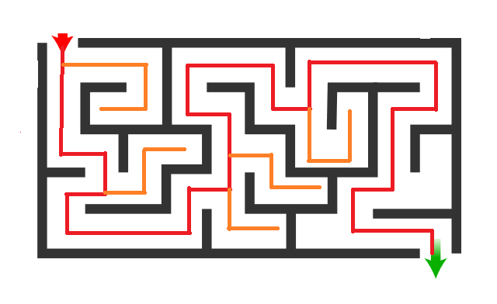
Is it possible to make this more efficient?

Slide 4
Landmark A* Search
Landmark A* utilises landmarks to increase the efficiency of the A* algorithm
These landmarks need to be established in advance and function as sort of checkpoints for the algorithm to utilise
Each landmark needs every node to have a heuristic value associated with so picking high impact landmarks is important

Slide 5
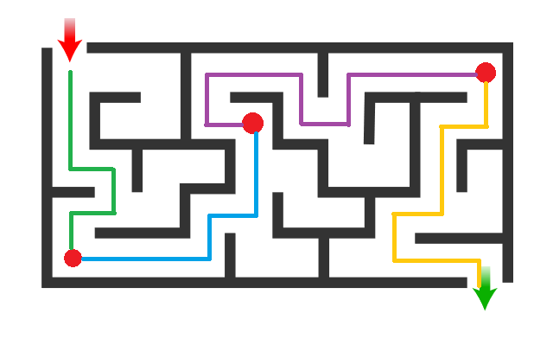
Better but still has some very noticeable issues.

Slide 6
Drawbacks of Landmarking
How many is too many?
Heuristic values must be calculated for each landmark not just the end point
Improperly placed landmarks could make runtime worse not better
Requires insight into where the pathing may have to to begin with works well if their are nodes that have to be passed through i.e. a hub on a rail network

Slide 7
Bidirectional Search
Similar to A* accept it starts at either end of the search space and works from start to goal and from goal to start stopping when the search areas connect
Faster than A* as the search complexity for A* is O(b^d) and bidirectional is O(b^(d/2))
Needs to compute to heuristic values for each node making this run in constant time like A*

Slide 8
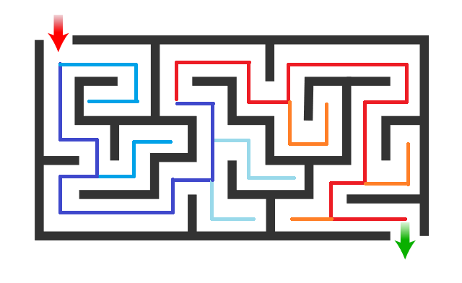
What happened?

Slide 9
References
A* Search Algorithm. (2018). Retrieved December 02, 2020, from https://www.geeksforgeeks.org/a-search-algorithm/
Bidirectional Search. (2020). Retrieved December 02, 2020, from https://www.geeksforgeeks.org/bidirectional-search/
Richter, S. (2012). Landmark-Based Heuristics and Search Control for Automated Planning

